Slide 1
SODV 2202
Object Oriented Programming
Module 1
Object Oriented Programming Concepts
Lesson 2
Creating Classes

Slide 2
Intro to OOPS
Object Oriented Programming is a programming paradigm, based on the concepts that are organized around objects, rather than functions or methods.
The main aim of OOP is to bind together the data and the functions that operate on them so that no other part of the code can access this data except that function.
Major OOPS Concepts
Class
Object
Encapsulation
Abstraction
Inheritance
Polymorphism

Slide 3
What Are Classes?
Classes are reusable components of code that combine data and functionality.
It represents the set of properties or methods that are common to all objects of one type.
Class
Data member (Field)
Function member (Method)

Slide 4
What Are Objects?
Objects are instances of a class.
An object is a combination of data and methods.
The data and the methods are called members of an object.
The objects communicate together through methods.
Each object can receive messages, send messages and process data.

Slide 5
Object Attributes
Object attributes are data bundled in the instance of the class.
Each object of the class has a separate copy of the instance variables.

Slide 7
Methods
Methods are functions defined inside the body of a class.
They are used to perform operations with the attributes of our objects.
Methods bring modularity to our programs.
Methods represent the behavioral part of the objects

Slide 8
Instances

Slide 9
Access Modifiers
Access modifiers set the visibility of methods and member fields.
C# has four access modifiers:
Public
Protected
private
internal.
The public members can be accessed from anywhere ( even outside the class)
The protected members can be accessed only within the class itself and by inherited and parent classes.
The private members are limited to the containing type, e.g. only within its class or interface.
The internal members may be accessed from within the same assembly (exe or DLL).

Slide 11
Constructors
A constructor is a special kind of a method, which is automatically called when the object is created.
Constructors do not return values.
The purpose of the constructor is to initiate the state of an object.
Constructors have the same name as the class.
If we do not write any constructor for a class, C# provides an implicit default constructor.
If we provide any kind of a constructor, then a default is not supplied.

Slide 13
Destructors
A constructor is called once when the object is created.
A destructor, or finalizer, is called once when the object is destroyed.
C# is memory managed: a garbage collector will automatically free memory.
The garbage collector is not guaranteed to run on a particular schedule, so finalizers cannot be relied on to run at any given time, or in any given order.

Slide 14
Initialization
Fields can be initialized using field initializers, constructors, or initialization lists.
If no constructor is written, the compiler will provide a default constructor.
Field Initializer
Constructor
Initialization List

Slide 15
Other Modifiers- Static Members
Static members are not associated with a particular instance.
Only 1 copy of static fields will exist.
They are useful in keeping track of the number of instances created.
Static methods can be called directly using the class name.
A static method can only work with static variables

Slide 16
Other Modifiers
There are two ways to signify that values assigned to a data member cannot change throughout the program
Constant Variables
Readonly Variables.
Constant variables do not belong to any concrete object within a class; it belongs fully to a class
They are implicitly static, and must have a field initializer
They are created using const keyword
Readonly variables can only be initialized within a constructor
Data members that are readonly can have different value for different instances of the same class.
They are created using readonly keyword.

Slide 17
Properties
Properties are special members inside a class, that are used to encapsulate the private data members of a class.
They are two accessor methods within them called get and set accessors
set accessor: used to assign a new value
get accessor: used to return the property value.
Syntax:
<access modifier> <return type> < property name>
{
get { }
set { }
}

Slide 18
Properties
using System;
class MyClass
{
private int x;
public int X
{
get { return x; }
set { x = value; }
}
}
class MyClient
{
public static void Main()
{
MyClass.X = 10;
int xVal = MyClass.X;
Console.WriteLine(xVal);//Displays 10
}
}

Slide 19
Auto Implemented Properties
To simplify programming and to make code shorter, we can make use of automatic properties
public int autoproperty
{
get;
set;
}

Slide 20
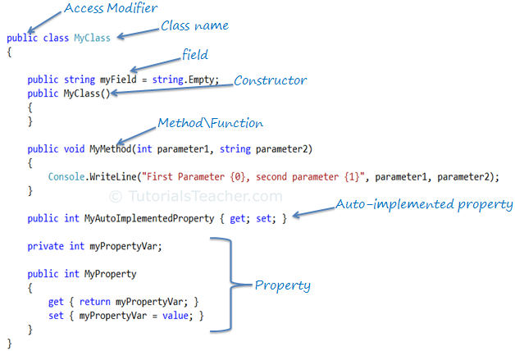

Slide 21
Example 1: Bank Account
Design a class describing a bank account. The account should have an ID number, a descriptive name, and contents value. Users should be able to deposit and withdraw funds from the account.

